Slide 1
Data Analytics: West Java Healthcare
Robby Nugraha - RevoU

Slide 2
About Portofolio
This project will analyze the statistics of health insurance and facilities in West Java to draw conclusions that can guide future decisions and actions regarding healthcare services and facilities in the region.

Slide 3
?
?
How can the data be modified or adjusted so that it can be presented ?
?
?
?
?
?
?
How to get a data ?
?
?
?
?
?
?
What application is used for this analysis?
?
?
Application
Tableau for Public Edition
Dataset
Link (Healthcare Facility): HC Facility
Link (Healthcare Security): HC Security
Modified or Adjusted?
You need to check both datasets first. If there is any missing data or missing values, please edit the data first. If not, proceed with the analysis of both datasets. The data taken does not contain any missing data or missing values.

Slide 4
Scope of Material
About Healthcare
Explanation about Healthcare & Healthcare in West Java
Healthcare Security
Explanation, Result, Conclusion
Healthcare Facility
Explanation, Result, Conclusion
Conclusion
Result & Conclusion about Healthcare Security & Facility in West Java
My Profile (Me)
All About me, project, and Source

Slide 5
About Healthcare

Slide 6




Healthcare
Healthcare refers to the maintenance, restoration, or promotion of a person's physical, mental, or emotional well-being, especially when performed by trained and licensed professionals.
Source:
Merriam-Webster Dictionary https://www.merriam-webster.com/dictionary/health%20care
Freepik

Slide 7
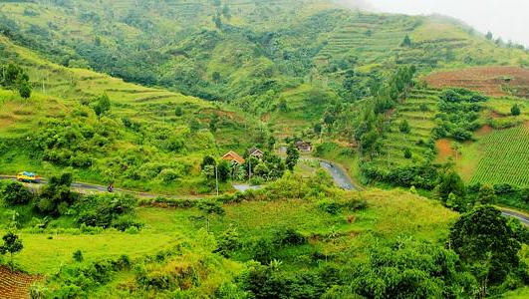
Healthcare in West Java
West Java, one of the most populous provinces in Indonesia, has a healthcare system that is constantly evolving to meet the needs of its growing population. While significant strides have been made in recent years, challenges remain in ensuring equitable access to quality healthcare, especially in rural areas.
Source:
Government of Indonesia: https://www.kemkes.go.id/eng/home
World Health Organization (WHO): https://www.who.int/about
Local news sources
Freepik

Slide 8


Source: Freepik
Healthcare Security
Healthcare Facility
Healthcare security refers to the safeguarding of patient information and the systems used to store and transmit it. This includes both physical and digital security measures to prevent unauthorized access, use, disclosure, modification, or destruction of patient data.
Healthcare facility refers to any location or organization that provides medical services or treatment.

Slide 9
Healthcare Security

Slide 10
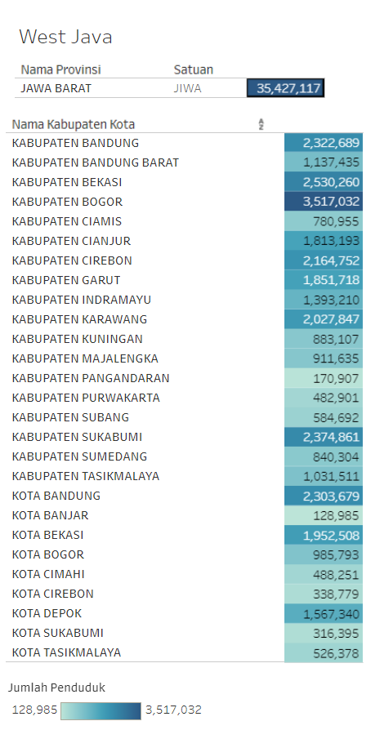
Healthcare Security
This is the population statistics of West Java. The population of West Java is 35 million people, with the largest population in the Bogor Regency, amounting to 3 million people, and the smallest population in the City of Banjar, amounting to 128 thousand people.

Slide 11
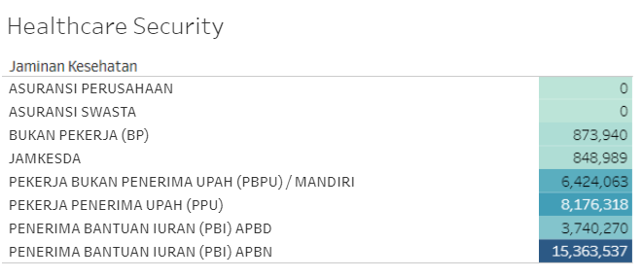
Healthcare Security
As for healthcare coverage, the population of West Java receives healthcare guarantees fully paid for by the national budget (APBN), covering 15 million people. Meanwhile, none of the population in West Java receives healthcare coverage from private or company insurance. The second largest source of healthcare coverage comes from wage earners, where the population is employed by companies that provide salaries, such as employees, civil servants (PNS), military personnel (TNI), contract employees (P3K), and others.

Slide 12
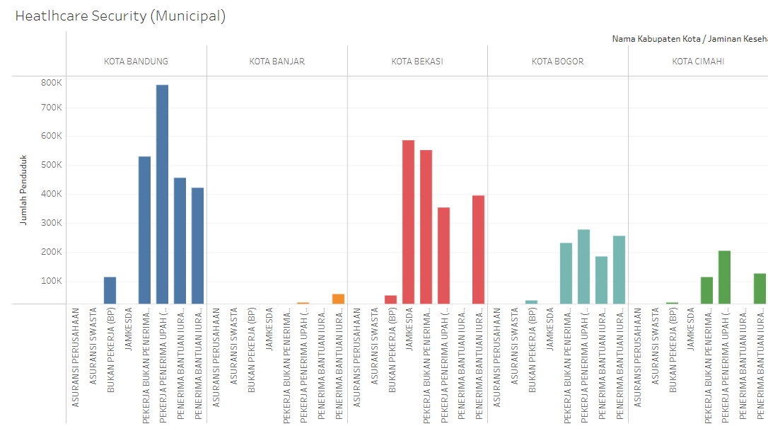
Healthcare Security
Below are the statistical data on insurance recipients among the residents of cities in West Java. Bandung City recorded the highest statistics for healthcare coverage recipients from wage earners, followed by non-wage earners, and then recipients of healthcare coverage from the regional and national budgets (APBD and APBN). The lowest statistics were found among non-working healthcare coverage recipients. No one received or utilized healthcare coverage from private, company, or regional health insurance (Jamkesda). In addition to Bandung, Bekasi City also recorded the highest statistics for healthcare coverage recipients from Jamkesda, followed by independent insurance, APBN healthcare recipients, wage earners, and non-workers. Meanwhile, no one received or utilized healthcare coverage from private, company insurance, or APBD.

Slide 13
Healthcare Security
Next are the highest statistical results from Bogor City, where the recipients of healthcare coverage come from wage earners, followed by those from the national budget (APBN), non-wage earners, regional budget (APBD), and non-workers. There are no recipients of healthcare coverage from private or company insurance, or Jamkesda. Meanwhile, Cimahi City dominates in healthcare coverage recipients from wage earners, followed by independent insurance (non-wage earners), APBN recipients, and non-workers. Again, there are no recipients of healthcare coverage from private, company insurance, Jamkesda, or APBD. The lowest statistical data is from Banjar City, which has few residents choosing insurance, whether from company insurance, private insurance, Jamkesda, non-workers, independent insurance, or APBD. The residents of this city prefer healthcare coverage from the national budget (APBN) and wage earners.

Slide 14
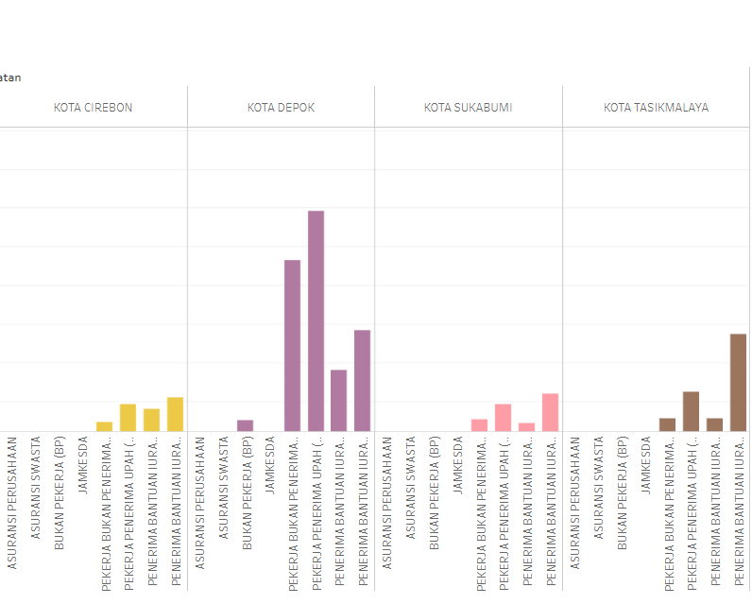
Healthcare Security
For this statistical data, the results show that Depok City has relatively high statistics in terms of healthcare coverage recipients, primarily from wage earners, followed by independent insurance, APBN, APBD, and non-workers. Meanwhile, no one received or utilized healthcare coverage from private, company insurance, or Jamkesda. In the cities of Cirebon, Sukabumi, and Tasikmalaya, the statistics are relatively constant and similar. However, healthcare coverage recipients from APBN frequently appear in significant numbers, followed by wage earners. Other data remain relatively stable, consistent, and similar.

Slide 15
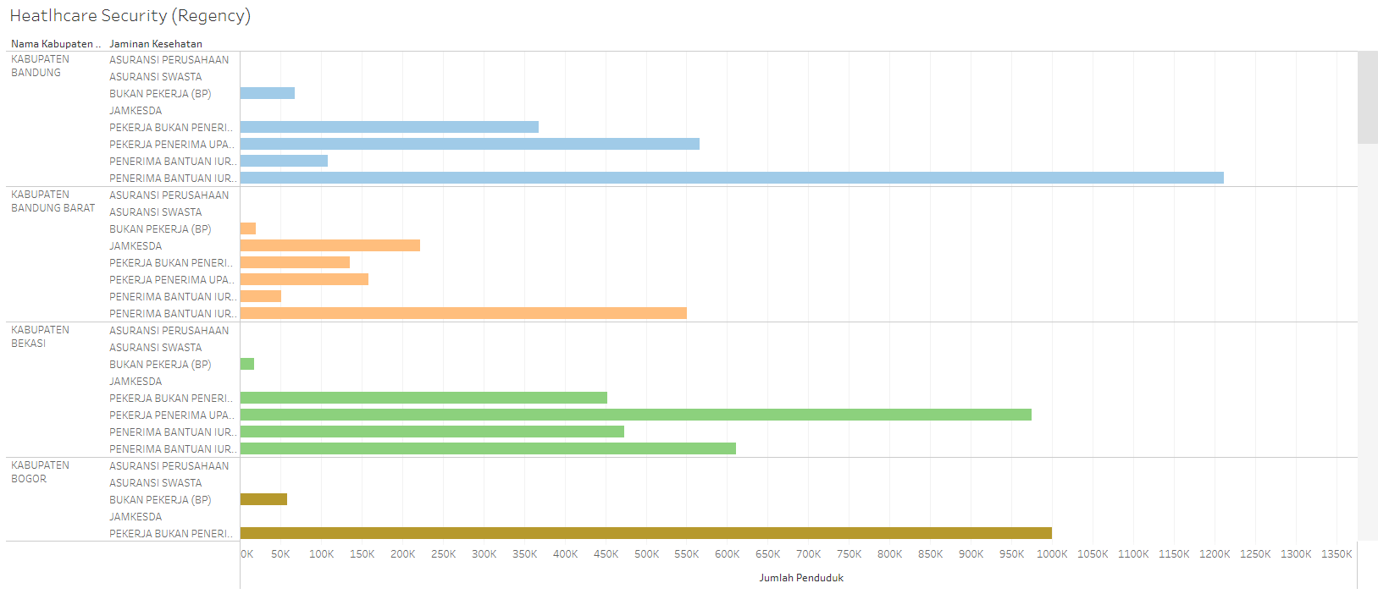
Healthcare Security
This is the statistical data on healthcare coverage recipients in the regencies of West Java. Based on the data displayed on the right, the average population in these three regions prefers healthcare coverage from the national budget (APBN) and wage earners. It is evident that Bandung Regency has relatively high statistics for healthcare coverage recipients from the APBN, followed by Bekasi Regency and then West Bandung Regency. For wage earners, Bandung Regency is again dominant, followed by Bekasi Regency, while West Bandung Regency shows relatively low statistics. Although there are other statistical data that vary in height, there are no healthcare coverage recipients from private or company insurance, Jamkesda, in the regencies of Bandung and Bekasi.

Slide 16
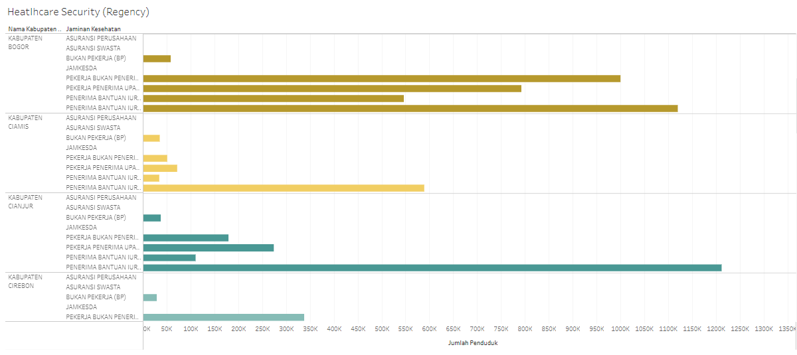
Healthcare Security
This is the statistical data from three regencies in West Java: Bogor, Ciamis, and Cianjur. The data indicates that these areas receive the most healthcare coverage from the national budget (APBN). The highest results are found in Cianjur Regency, followed by Bogor Regency, and then Ciamis Regency. Although other data shows relatively low results, Bogor Regency dominates with the highest number of healthcare coverage recipients from independent insurance, wage earners, and the regional budget (APBD). There are no recipients of healthcare coverage from private or company insurance, or Jamkesda in any of the three regions.

Slide 17
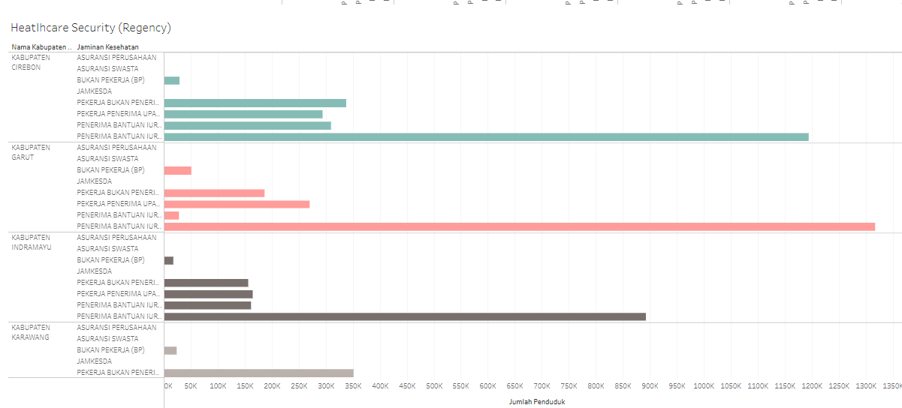
Healthcare Security
This is the statistical data from three regencies in West Java: Cirebon, Garut, and Indramayu. Similar to the previous statistical data, it indicates that these regions receive the most healthcare coverage from the national budget (APBN). The highest results are found in Garut Regency, followed by Cirebon Regency, and then Indramayu Regency. Other data show relatively consistent and uniform results, although Cirebon Regency has the most dominant figures; Garut Regency stands out with significantly lower statistics for healthcare coverage recipients from the regional budget (APBD) compared to the other two regencies. There are no recipients of healthcare coverage from private or company insurance, or Jamkesda in any of the three regions.

Slide 18
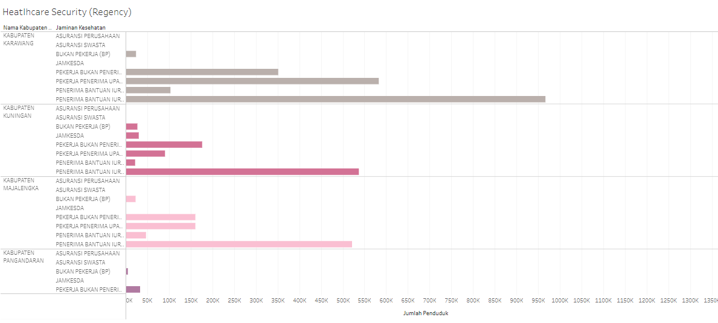
Healthcare Security
This is the statistical data from three regencies in West Java: Karawang, Kuningan, and Majalengka. Similar to the previous statistical data, it indicates that these regions receive the most healthcare coverage from the national budget (APBN). The highest results are found in Karawang Regency, followed by Kuningan Regency, and then Majalengka Regency, although the data results for the latter two regions are quite close. Other data show relatively consistent, uniform results, although Karawang Regency dominates in the area of healthcare coverage recipients from wage earners. There are no recipients of healthcare coverage from private or company insurance, or Jamkesda in any of the three regions.

Slide 19
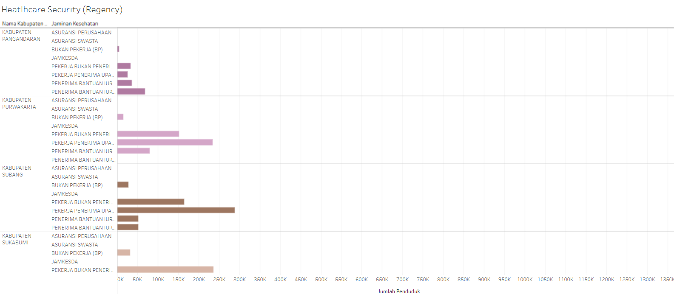
Healthcare Security
This is the statistical data from three regencies in West Java: Pangandaran, Purwakarta, and Subang. The results differ slightly from the other data because these regions receive healthcare coverage from wage earners. The highest results are found in Subang Regency, followed by Purwakarta Regency, and then Pangandaran Regency. Karawang Regency does not receive healthcare coverage from the national budget (APBN), while the other two regions do. Pangandaran Regency shows relatively low results compared to the other two regions. There are no recipients of healthcare coverage from private or company insurance, or Jamkesda in any of the three regions, and additionally, the residents of Purwakarta Regency do not receive healthcare coverage from the APBN.

Slide 20
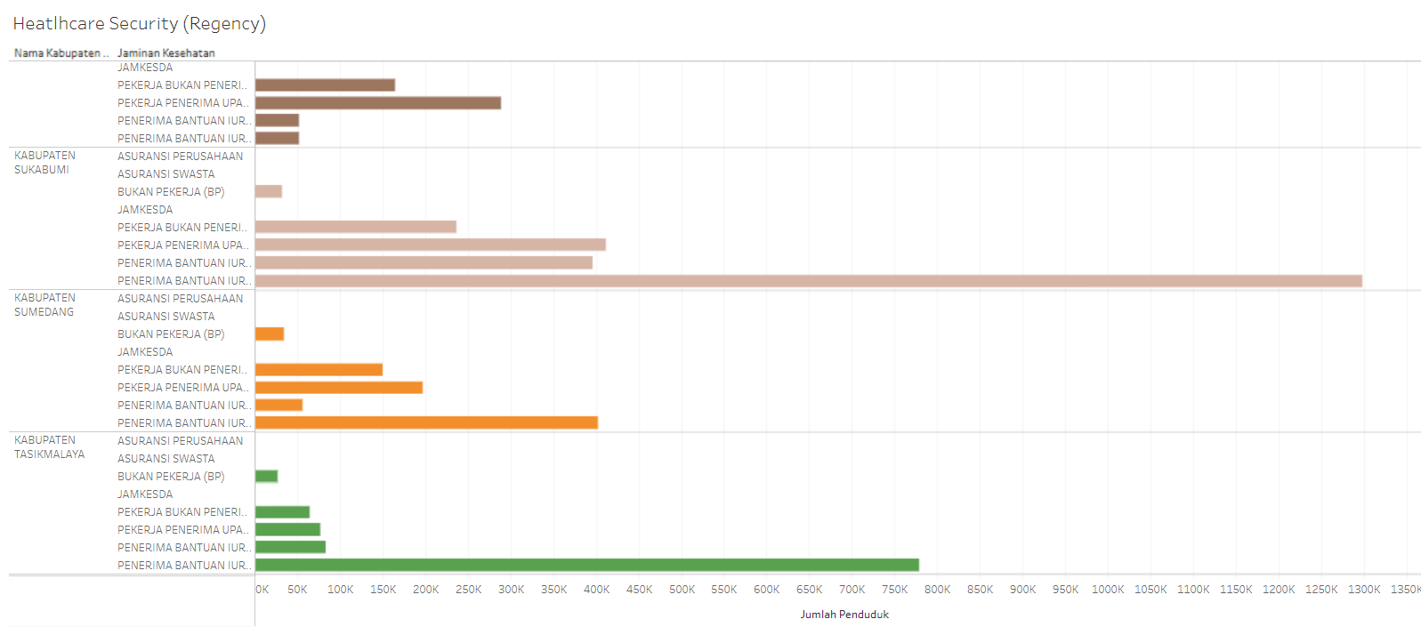
Healthcare Security
This is the statistical data from three regencies in West Java: Sukabumi, Sumedang, and Tasikmalaya. Similar to the statistical data from other regions, except for the three previous areas, this data indicates that these regions receive the most healthcare coverage from the national budget (APBN). The highest results are found in Sukabumi Regency, followed by Tasikmalaya Regency, and then Sumedang Regency. Other data show relatively consistent, uniform results, although Sukabumi Regency dominates in the area of healthcare coverage recipients from wage earners, the regional budget (APBD), and independent insurance. There are no recipients of healthcare coverage from private or company insurance, or Jamkesda in any of the three regions.

Slide 21




Conclusion about Healthcare Security
The data shows that the residents of West Java province most commonly use healthcare coverage from the national budget (APBN), regional budget (APBD), independent insurance, and wage earners. Only a few regions utilize Jamkesda for healthcare coverage. Company and private insurance are not used by any residents in the province of West Java.
Source: Freepik

Slide 22
Healthcare Facility

Slide 23
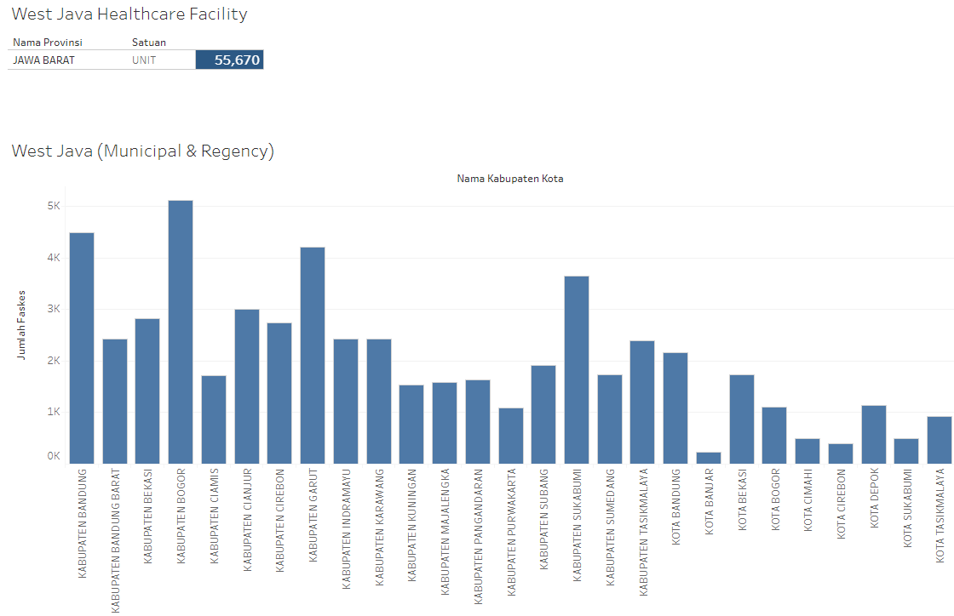
Healthcare Security
This is the statistical data on healthcare facilities in the province of West Java. It includes the number of healthcare facilities not only in the entire province but also across various regencies and cities within West Java. As seen in the data, the highest number of healthcare facilities is located in Bogor Regency, followed by Bandung Regency, Garut Regency, and Sukabumi Regency. The fewest healthcare facilities are found in Banjar City. Other regions show relatively consistent and uniform data.

Slide 24
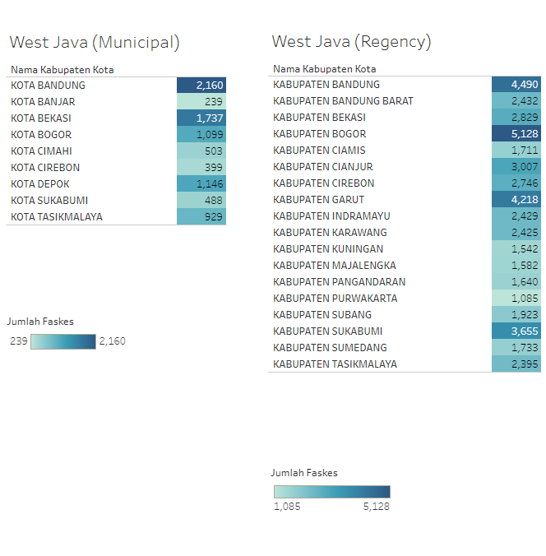
Healthcare Security
This is the statistical data on healthcare facilities in the regencies and cities of West Java province, shown separately. In the cities, the highest number of healthcare facilities is located in Bandung City, while the fewest are in Banjar City. In the regencies, Bogor Regency has the most healthcare facilities, while Purwakarta Regency has the fewest. Other regions show relatively consistent and even statistical data.

Slide 25
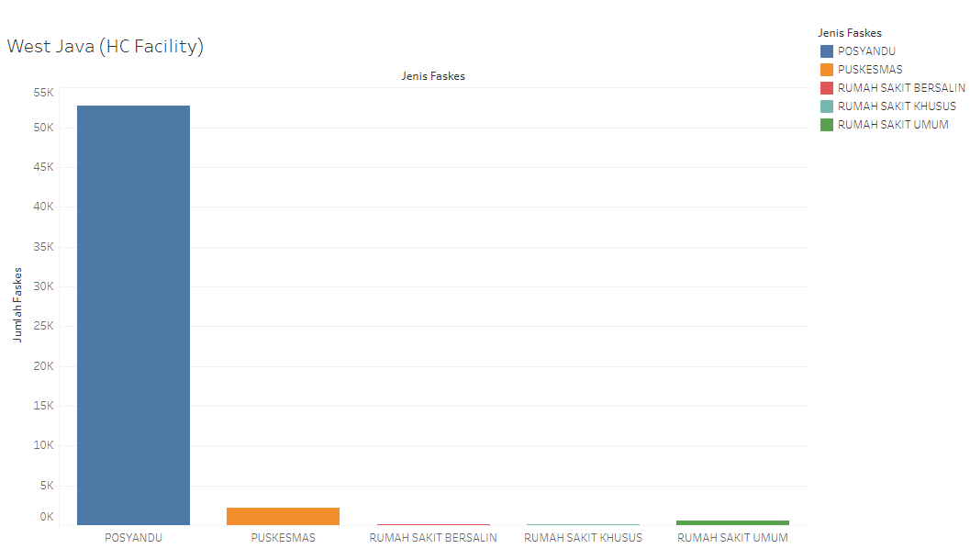
Healthcare Security
This is the statistical data on healthcare facilities in West Java. Based on the results, posyandu (integrated health posts) are the most common healthcare facilities, while maternity and specialized hospitals have the fewest facilities across all regions of West Java province. The factors contributing to posyandu being the most prevalent include demographics, geography, human resources, socio-economic conditions, and government policies. These policies mandate that posyandu reach remote areas to ensure that communities receive healthcare services similar to those provided in hospitals. As a result, *posyandu* have become the most numerous healthcare facilities.

Slide 26
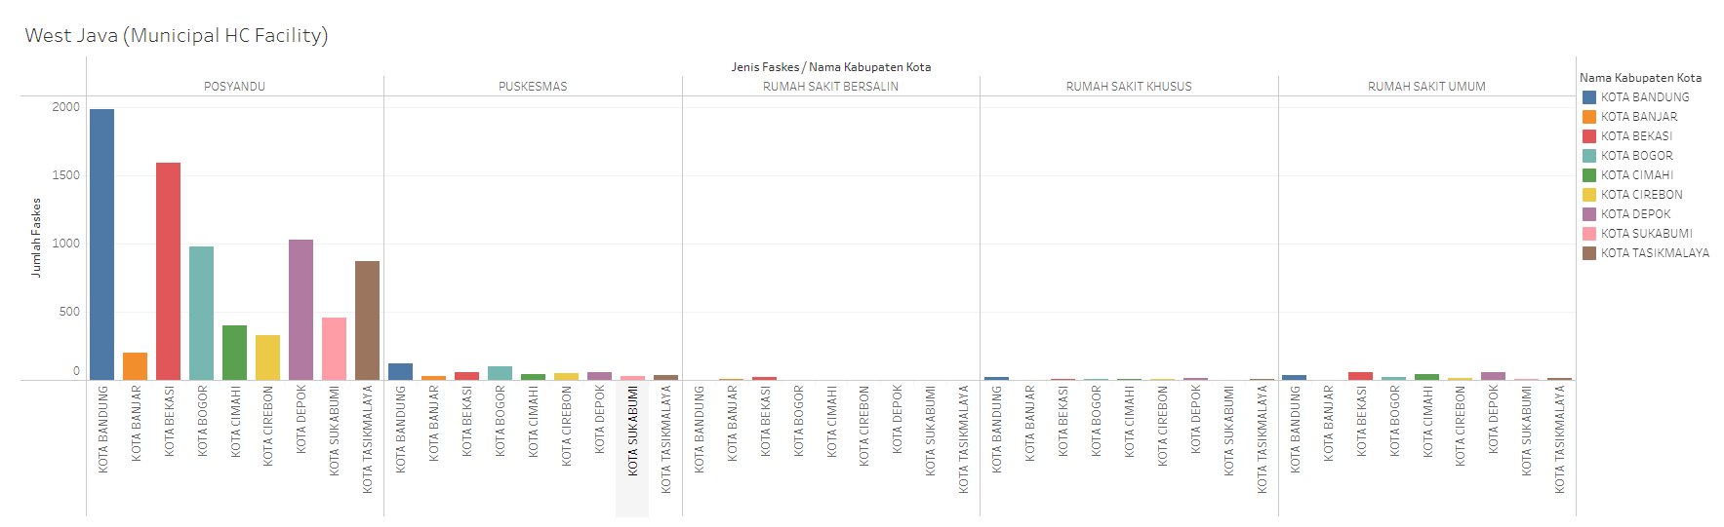
Healthcare Security
This is the statistical data on healthcare facilities in urban areas. Based on the results, posyandu (integrated health posts) are the most common and preferred healthcare facilities in the cities. The city with the most posyandu is Bandung, followed by Bekasi, and then other areas. The lowest statistical data, with some areas having none at all, are for maternity hospitals. Cities such as Bogor, Cimahi, Cirebon, Depok, Sukabumi, and Tasikmalaya do not have any maternity hospitals. Other healthcare facilities are generally more available, but there are still facilities present in each city.

Slide 27
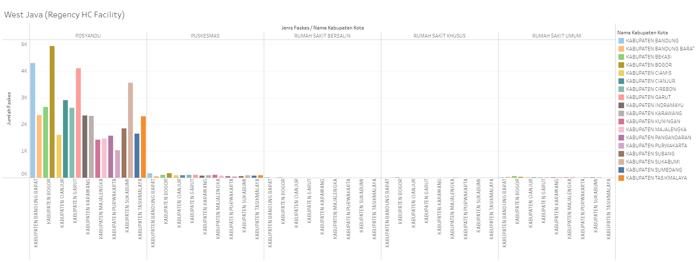
Healthcare Security
This is the statistical data on healthcare facilities in regency areas. Similar to the urban areas mentioned in the previous slide, posyandu (integrated health posts) are the most common and preferred healthcare facilities in the regencies. The highest number of posyandu is in Bogor Regency, while the lowest is in Purwakarta Regency. The least common facilities, with some areas having none at all, are maternity hospitals and specialized hospitals. Puskesmas (community health centers) have relatively low availability, and general hospitals also have low availability, though they are still present in the regencies.

Slide 28


Conclusion about Healthcare Facility
The data shows that posyandu (integrated health posts) are the most common and favored healthcare facilities in West Java province. Although posyandu are the most prevalent and popular, other healthcare facilities are also present in every region of West Java. However, maternity hospitals and specialized hospitals are very few and, in some cases, almost nonexistent, whether in regency or city areas.
Source: Freepik

Slide 29
Conclusion
Based on the results, it is clear that some regions, both in regencies and cities, still lack equal access to healthcare facilities and coverage, especially in areas with smaller populations. Therefore, a further review is needed regarding healthcare services and facilities in these regions. Attention should not only be given to certain areas but to all regions, ensuring that everyone receives equitable access to healthcare coverage and facilities. A key point for reassessment in healthcare coverage is the insurance provided by companies, private insurers, and Jamkesda, as there are still regions where these coverages are not accessible. These areas need to be addressed, whether through company regulations or by providing coverage that is easy, fast, efficient, and reliable to encourage more residents to utilize such healthcare plans. In addition to healthcare coverage, healthcare facilities also need to be improved, as some regions lack maternity hospitals and specialized hospitals. Therefore, these facilities should be expanded in areas where they are absent. With these two facilities in place, people would no longer need to visit general hospitals for treatments, as specialized hospitals would cater to specific medical needs. Not all areas have access to specialized or maternity hospitals, even though they may have general hospitals. Moreover, attention should not only be focused on these two types of facilities but on other healthcare services as well, since access is not yet uniform across regions. While posyandu (integrated health posts) are already favored by the public, puskesmas (community health centers) serve as a secondary option to avoid overwhelming posyandu, as not all posyandu provide services for all types of illnesses.General hospitals also need to be increased, whether in terms of facilities, rooms, or medical equipment. The most important aspects of healthcare facilities are access, regulation, and procedures. If these three aspects improve, residents will feel more comfortable, with easier and faster access to medical care.

Slide 30

My Profile
Robby Nugraha
LinkedIn: Let's Connect
GitHub: Coming Soon (Check on Caption)
Tableau View: Check on Caption

